Slide 1
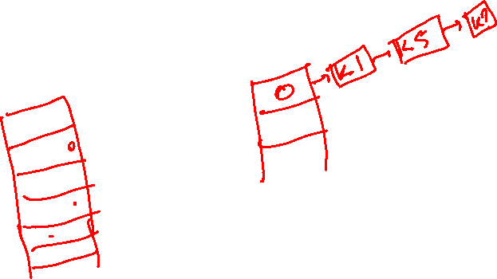
Hash Tables

Slide 2
Contents
Direct-Address tables
Hash Tables
Hash Functions
Open Addressing

Slide 3
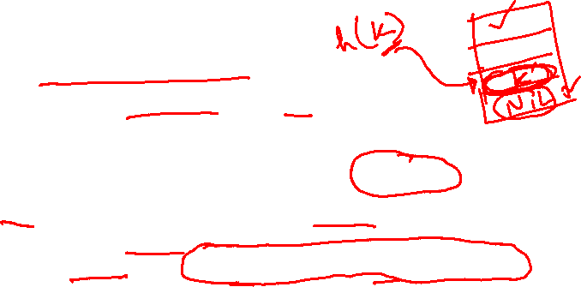
Open Addressing
An alternative to chaining for handling collisions.
Idea:
Store all keys in the hash table itself.
Each slot contains either a key or NIL.
To search for key k:
Examine slot h(k). Examining a slot is known as a probe.
If slot h(k) contains key k, the search is successful. If the slot contains NIL, the search is unsuccessful.
There’s a third possibility: slot h(k) contains a key that is not k.
Compute the index of some other slot, based on k and which probe we are on.
Keep probing until we either find key k or we find a slot holding NIL.

Slide 4

Probe Sequence
Sequence of slots examined during a key search constitutes a probe sequence.
Probe sequence must be a permutation of the slot numbers.
We examine every slot in the table, if we have to.
We don’t examine any slot more than once.
The hash function is extended to:
h : U × {0, 1, …, m – 1} → {0, 1, …, m – 1}
probe number slot number
⟨h(k,0), h(k,1),…,h(k,m–1)⟩ should be a permutation of ⟨0, 1,…, m–1⟩.

Slide 5

Computing Probe Sequences
The ideal situation is uniform hashing:
Generalization of simple uniform hashing.
Each key is equally likely to have any of the m! permutations of ⟨0, 1,…, m–1⟩ as its probe sequence.
It is hard to implement true uniform hashing.
Approximate with techniques that at least guarantee that the probe sequence is a permutation of ⟨0, 1,…, m–1⟩.
Some techniques:
Use auxiliary hash functions.
Linear Probing.
Quadratic Probing.
Double Hashing.

Slide 6
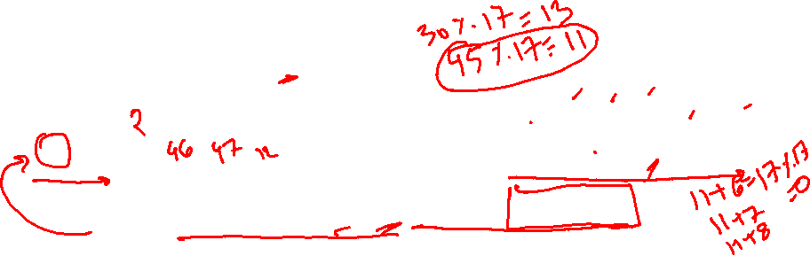
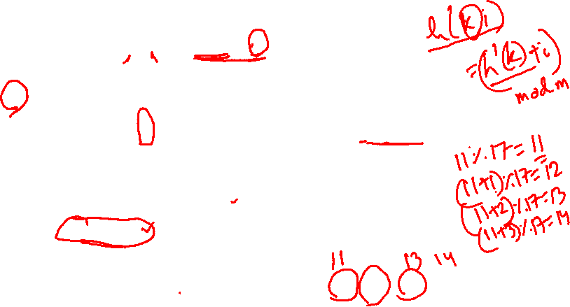
Linear Probing
given an ordinary hash fn. h’: U → [0, 1, …, m-1], called the
auxiliary hash function, define the hash function
h(k, i) = ( h’(k) + i ) mod m
for i = 0, 1, …, m-1.
Therefore, given key k the first slot probed is T[ h’(k) ], i.e., the
slot given by the auxiliary hash fn. Next probed are
T[ h’(k)+1 ], T[ h’(k)+2 ], ....
key
Probe number
Auxiliary hash function
divisor = b (number of buckets) = 17.
Home bucket = key % 17.
0
4
8
12
16
34
0
45
6
23
7
28
12
29
11
30
33
Put in keys: 6, 12, 34, 29, 28, 11, 23, 7, 0, 33, 30, 45
Notes:
6

Slide 7
Linear Probing
Suffers from primary clustering:
Long runs of occupied sequences build up.
Long runs tend to get longer, since an empty slot preceded by i full slots gets filled next
Hence, average search and insertion times increase.

Slide 8
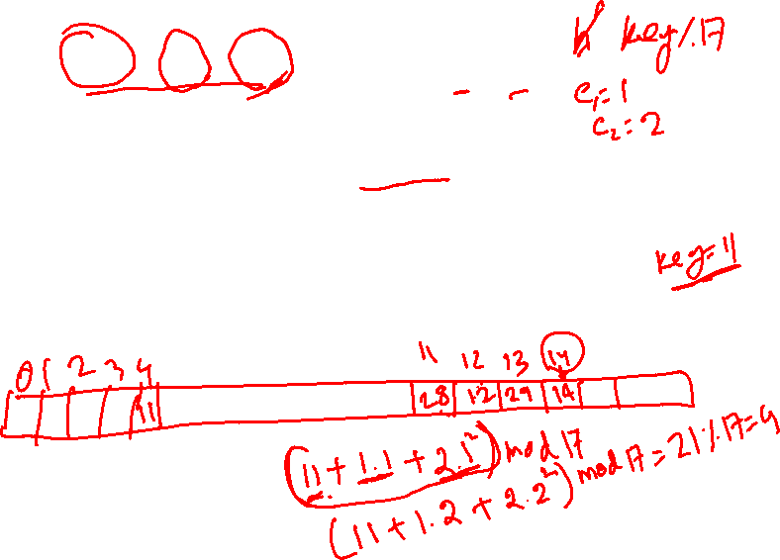
Quadratic Probing
h(k,i) = (h′(k) + c₁i + c₂i²) mod m c₁≠ c₂
The initial probe position is T[h′(k)], later probe positions are offset by amounts that depend on a quadratic function of the probe number i.
key
Probe number
Auxiliary hash function

Slide 9

Double Hashing
h(k,i) = (h₁(k) + i h₂(k)) mod m
Two auxiliary hash functions.
h₁ gives the initial probe. h₂ gives the remaining probes.
key
Probe number
Auxiliary hash functions

Slide 10
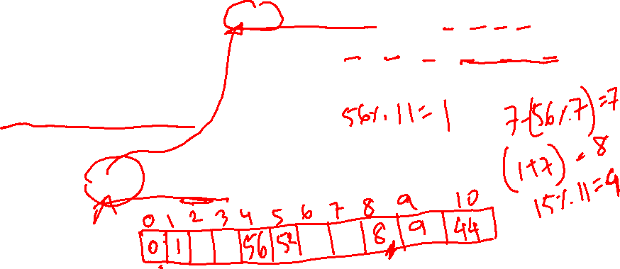
Double Hashing
You are given an initially empty hash table with capacity 11 and hash function H (x) = x % 11. Keys 0, 1, 8, 9 are already in the table. Insert keys 52, 44, 56, 53, 61, 64.
Resolve collisions (if any) using double hashing with
H’ (x) = 7 – (x % 7)
h(k,i) = (h₁(k) + i h₂(k)) mod m

Slide 11
